Slide 1
Smart Schools Bond Act
Marion Central School District

Slide 2
Purpose
Funding to support educational technology and infrastructure in order to improve learning and opportunity for students to succeed in the 21st century economy.

Slide 3
Funding to
High speed broadband or wireless connectivity
Learning technology equipment
Instructional space for Pre-K
High-tech security features on campus

Slide 4
Conditions
Demonstration of need
Adequate technological infrastructure
Sustainability
Professional Development
Technical Support
Notes:
Demonstration of need
Adequate technological infrastructure
Sustainability
Professional Development
Technical Support

Slide 5
Allocation
$1,038,923
One-time allocation
No deadlines for submission
Funds do not expire
Funds can be reimbursed on an ongoing basis
Funding mechanism not set up yet

Slide 6
Steps
Review allocation amount
Identify district needs
Stakeholder engagement
Capital planning ?
Instructional technology plan-submitted and approved
Preliminary Plan submission to BOE (once online form is available)
30 day Review-public comments accepted
Public Hearing
Final plan-BOE Approval
Submit to SED
Expenditure and reimbursement of funds.

Slide 7
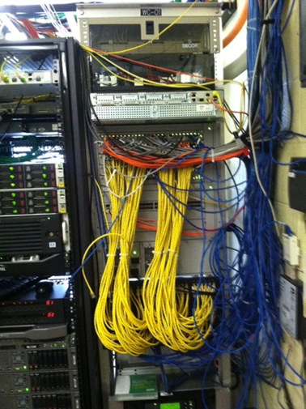
School Connectivity
Infrastructure Upgrade
Components
Servers
Switches
Wireless
Cabling
Management Center

Slide 8
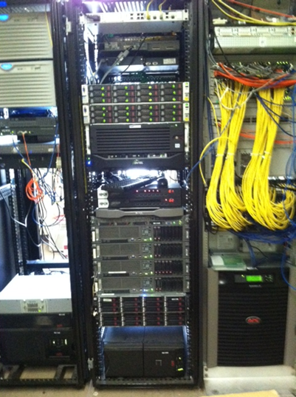
Servers
7 Physical servers
5 Esxi Hosts
1 Domain Controller
1 VCenter server

Slide 9
Switches
Core Switch- HS
Core Switch-ES
29 Edge Switches

Slide 10
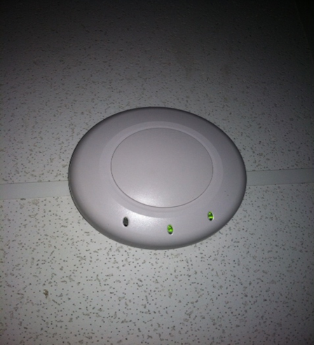
Wireless
Wireless Access Management
Wireless Access Points

Slide 11
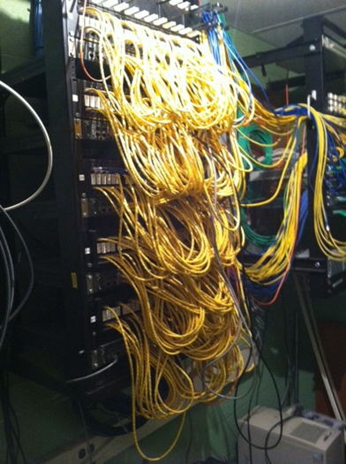
Cabling
Upgrade to cat6 or cat6a
Upgrade fiber inside to OM3 or OM4

Slide 12
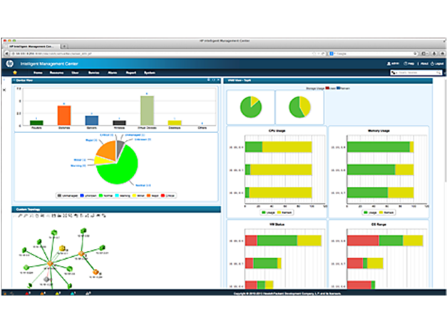
HP IMC
HP IMC Enterprise Software Platform with 50-node E-LTU
HP IMC WSM Software Module with 50 Access Point E-LTU
HP 3 year 24x7 Care Pack Service
Additional Service Charges

Slide 13
Questions or comments?

