Slide 1
Smart Schools Bond Act - Planning

Slide 2
Smart Schools Bond Act of 2014
The Smart Schools Bond Act of 2014 was approved in a statewide referendum Nov. 2014
Authorizes state to borrow $2 Billion
Improve educational technology and infrastructure
To improve learning and opportunity for NYS students
Rush-Henrietta allocation $2,944,081
Fund availability does not expire
An Improvement Plan must be submitted
Linked to district’s long-term educational planning and technology investments
Provide learning opportunities beyond the class

Slide 3
Smart Schools Investment Process
District Posts Preliminary Plan 30 Days
District Prepares Final Plan
Final Plan Board Approval
District Submits Final Plan
District Consults w/Stakeholders and Prepares Preliminary Plan
Preliminary Plan Board Approval
Public Notice and Hearing

Slide 4
R-H Technology Plan
Vision
Seamless integration of technology devices in every R-H classroom that allows each student the automatic access to the Internet to obtain information, communicate & collaborate with others, and create products of their learning.

Slide 5
R-H Technology Plan Outcomes
A Student-Empowered Learning Environment
21st Century Skills and Literacy integrated into the curriculum
Timely Access to Data to Inform Instruction

Slide 6
Categories Not Allowed in Requests
Professional development
Staffing
Ongoing technical support
Software
Subscription services
Phone system

Slide 7
Project Categories Allowed but Not Applicable to Rush-Henrietta
Replacement of Classroom Trailers
Connectivity Projects for Communities
Pre-Kindergarten Classrooms- SED says we are unable to use for Kindergarten project at Vollmer
Student Devices- With Current 5 year technology Plan no need to use this funding for devices

Slide 9
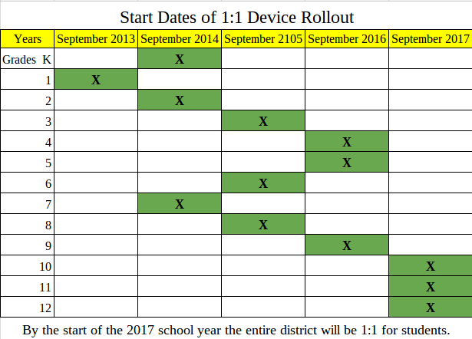

Slide 10
Project Categories
School Connectivity
High speed broadband
Wireless connectivity
High Tech Security Features

Slide 11
School Connectivity Proposal
Wireless Access Points
Wired switch system
Servers and storage
Ethernet wiring

Slide 12
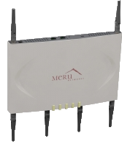
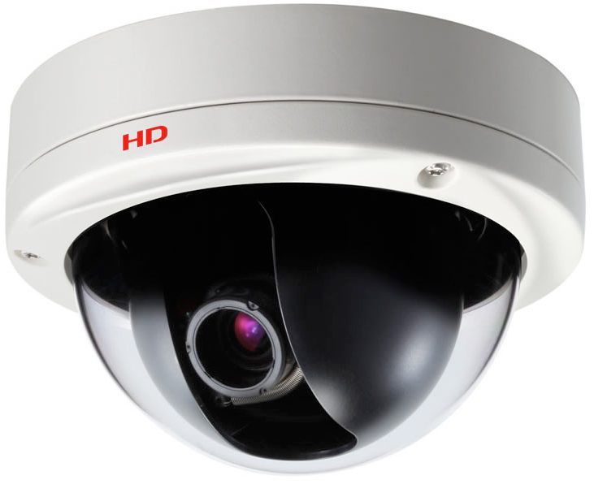
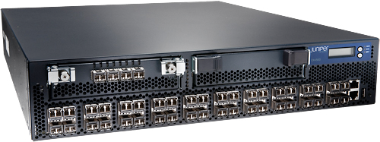
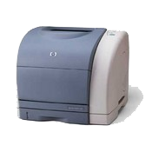
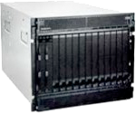
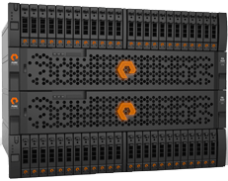
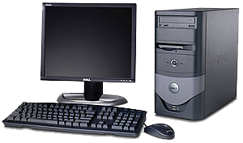
Camera
Internet
Wireless
access
point
Laptop
Core switch
Edge
switch
Printer
Storage
Servers
Desktop

Slide 13
Wireless Infrastructure Upgrade Benefits
Enables increased density of student machines in classrooms
Directly supports online testing
Allows increased streaming of video and audio simultaneously
Faster connections
Commonality of Infrastructure
Best scenerio for Bring Your Own Device (BYOD)

Slide 14
WiFi Standards
Standard | Year | Theoretical Speed (Mbps) | Actual Speed (Mbps)
802.11b | 1999 | 11 | 3
802.11ag | 2003 | 54 | 20-30
802.11n | 2009 | 600 | 40-70
802.11ac | 2013 | 1,300 | 100-400

Slide 15
Wireless Access Point Upgrade
Current fleet of Meru access points started being installed 6 - 7 years ago
Phase 1 (2016-17)
Wireless 802.11ac Wave 2 Upgrade – 300 devices
Phase 2 (2018-19)
Replace 350 devices – current industry standard
Industry Standard- Meru bought out, technology being phased out
Select new district standard – Cisco or Aruba
Faster connections
Commonality of Infrastructure

Slide 16
Wireless Access Points Upgrade Costs Phase 1 (2016-17)
Description | Cost
300 wireless 802.11AC Access Points | $240,000
Redundant controllers capable of supporting >700 WAPs each | $50,000
Web based wireless monitoring system | $2,000
Guest portal system that supports extended term BYOD and guest users | $25,000
Licensing to support 5,000 district devices, 2,000 BYOD student devices and 500 concurrent guest devices | $45,000
Phase 1 Wireless Upgrade | $362,000

Slide 17
Wireless Access Points Upgrade Costs Phase 2 (2018-19)
Description | Cost
350 wireless 802.11AC Access Points | $255,000
Licensing & support for above units to support 5,000 district devices, 2,000 BYOD student devices and 500 concurrent guest devices | $70,000
Phase 2 Wireless Upgrade | $325,000
Total Wireless Upgrade | $687,000

Slide 18
Wired Switch System Upgrade
Adoption of 2.5Gbps switch technology in network closets
Fully supports new 802.11AC wave 2 technologies
Required to support more intense end-user experience
Faster speed
Videos, etc.
Initiate three year upgrade to encompass all district buildings
Supports connections from new Wireless 802.11 access ports
Provides higher density of use, increased volume of content delivery (video, etc.)
Current 1 Gb switches will lose manufacturer support in 5 yrs

Slide 19
Wired Switch System
Description – Phase 1 | Cost | Year
Top of Rack 2.5 Gbps switches | $200,000 | 2016 - 17
Edge port 1 Gbps switches | $180,000 | 2016 -17
Phase 1 Wired Switch Upgrade | $380,000
Description – Phase 2 | Cost | Year
Top of Rack 2.5 Gbps switches | $200,000 | 2018 -19
Edge port 1 Gbps switches | $180,000 | 2018 -19
Phase 2 Wired Switch Upgrade | $380,000
Total Wired Switch Upgrade | $760,000

Slide 20
Data Center Upgrade
R-H currently has two Data Centers – HS and TOC
Provide redundancy/disaster recovery
Ongoing balances load to maximize capacity
Data Centers host majority of district systems
Active Directory
Applications / Student file storage
Backup, monitoring and database servers

Slide 21
Data Center Upgrade
Description | Cost | Year
Replacement of current servers | $150,000 | 2018 -19
SAN (Storage Area Network) Replacement (1 each site) | $50,000 | 2016-17
Total for Data Center upgrade | $200,000

Slide 22
Elementary Wiring – CAT6
R-H currently has three types of data wiring – CAT 5, CAT 5e and CAT6
CAT5 (oldest) – is in elementary buildings
CAT6 is current standard – is in secondary bldgs.
New wireless standard 802.11 works best with CAT6
Maximizes capacity and speed
Works with CAT5 but doesn’t utilize full capacity
Relocate ethernet drops in secondary buildings (center of room vs. corner for TV system)
Upgrading each elementary building as funds are available

Slide 23
Technology Proposal Recap
District Technology Infrastructure
Wireless Access Points
Wired switch system
Servers and storage
Ethernet wiring

Slide 24
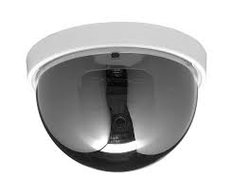
Security Proposals
Public Address Systems
Security Cameras

Slide 25
Security Systems - PA Systems
Mass notification / Public Address System-all schools
Multi-function PA system
Signboard, synchronized clock, bell scheduler, two-way communication, scrolling text & configurable strobe flashers
Provides emergency notification – can also be sent to cell phones
Replaces current 15+ year old systems
Current system no longer has technical support

Slide 26
Security Systems - Security Cameras
Upgrade Security cameras and servers
Many of current servers in building are at 5 year expected life
Seven buildings have servers with capacity less than recommended 30 days storage
No remote monitoring of building servers, failures not known until physically inspected
Consolidate to central storage – 24 hour system monitoring, 30 day + storage capacity for all buildings, reduces number of building servers to five Virtualize NVR servers, add to central cluster
Districtwide replace all analog cameras with 16MP cameras and add additional cameras

Slide 27
Security Systems Total
Description | Cost | Year
PA system replacement – all schools | $512,000 | 2018 -19
Up to 32 additional cameras | $90,000 | 2017 -18
Video management system upgrade | $84,000 | 2016-17
Centralized video storage server | $157,000 | 2016-17
Analog exterior zoom cameras replaced with 16MP cameras | $145,000 | 2017 -18
Total for All Security Projects | $988,000

Slide 28
Smart Schools Investment Cost Summary

Slide 29
Smart Schools Investment Process
SED Staff Review and Approve Plan
SSBA Review Board Review and Approve Plan
District Begins Project(s)
District Submits Reimbursement Request(s)
SED/State Reimburses District
District Submits Final Plan
[START]

