Slide 1
Smart Schools Investment Plan
Public Hearing
March 2016

Slide 2
About NY Smart Schools Bond Act:
The Smart Schools Bond Act was passed in the 2014-15 Enacted Budget and approved by the voters in a statewide referendum held during the 2014 General Election on Tuesday, November 4, 2014.
The Smart Schools Bond Act (SSBA) authorized the issuance of $2 billion of general obligation bonds to finance improved educational technology and infrastructure to improve learning and opportunity for students throughout the State.
The SSBA requires that a Review Board review and approve districts’ Smart Schools Investment Plans before any funds may be made available for the program
This will not have any impact on local taxes or the school budget

Slide 3
More about NY Smart Schools Bond Act:
Passed by NYS taxpayers in November 2014 election
Objective: Improve Educational Technology & Infrastructure
$2 Billion Statewide (WCSD allocation= $1,027,801)
NYS Review Board meets quarterly to approve requests
Funds distributed on a “reimbursement basis”
90 day reimbursement plan
Funds never expire, may submit multiple or revised plans
Cannot generate State Aid

Slide 4
District Process:
Identify Needs with help of District Technology Committee
Prepare Preliminary Plan
Board Approval of Preliminary Plan (Jan 27th, 2016)
District Posts Preliminary Plan (Jan 28th , Written & Electronic Feedback)
Public Notice & Hearing ( March 16th 2016, 2 Week Notice Required)
District Adjusts & Prepares Final Plan
Board Approval of Final Plan ( April 6th, 2016)
Post Final Plan on District Website
District Submits Final Plan for NYSED Approval
Amendments:
Plans may be amended after the initial approval has been approved. Any amendment of an approved Plan that would result in a change of more than 25 percent of approved budget expenditures will require the district superintendent to post the proposed amendments on the district website for two weeks and receive comments from the public in writing or at a normally convened meeting of the Board.

Slide 5
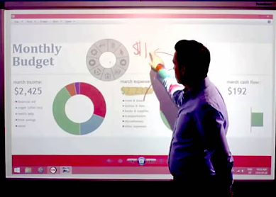
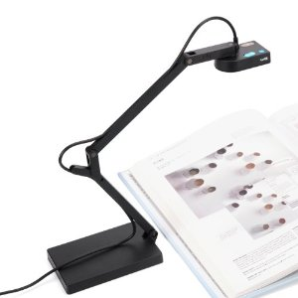
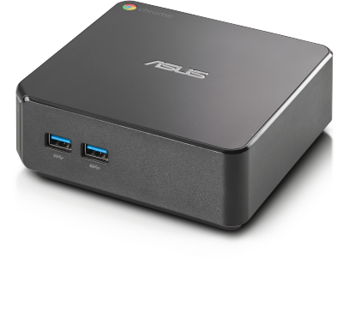
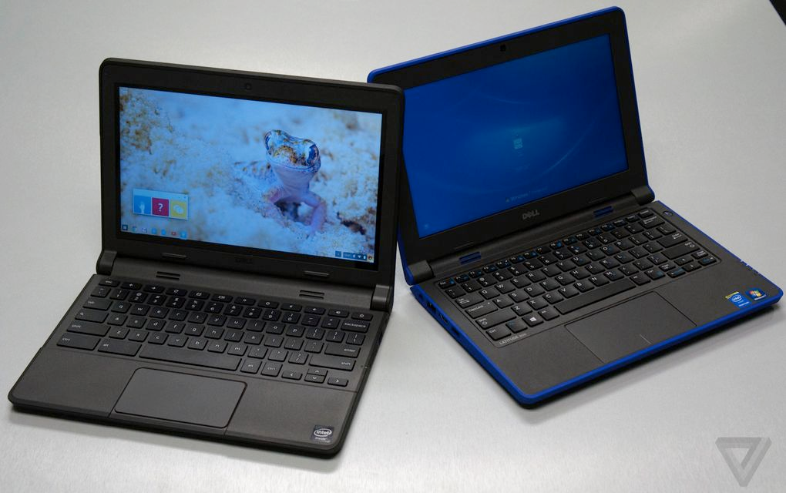
Proposed Items
USB Document Cameras
Chromeboxes
70” Interactive Touchscreens
iPads
Chromebooks

Slide 6
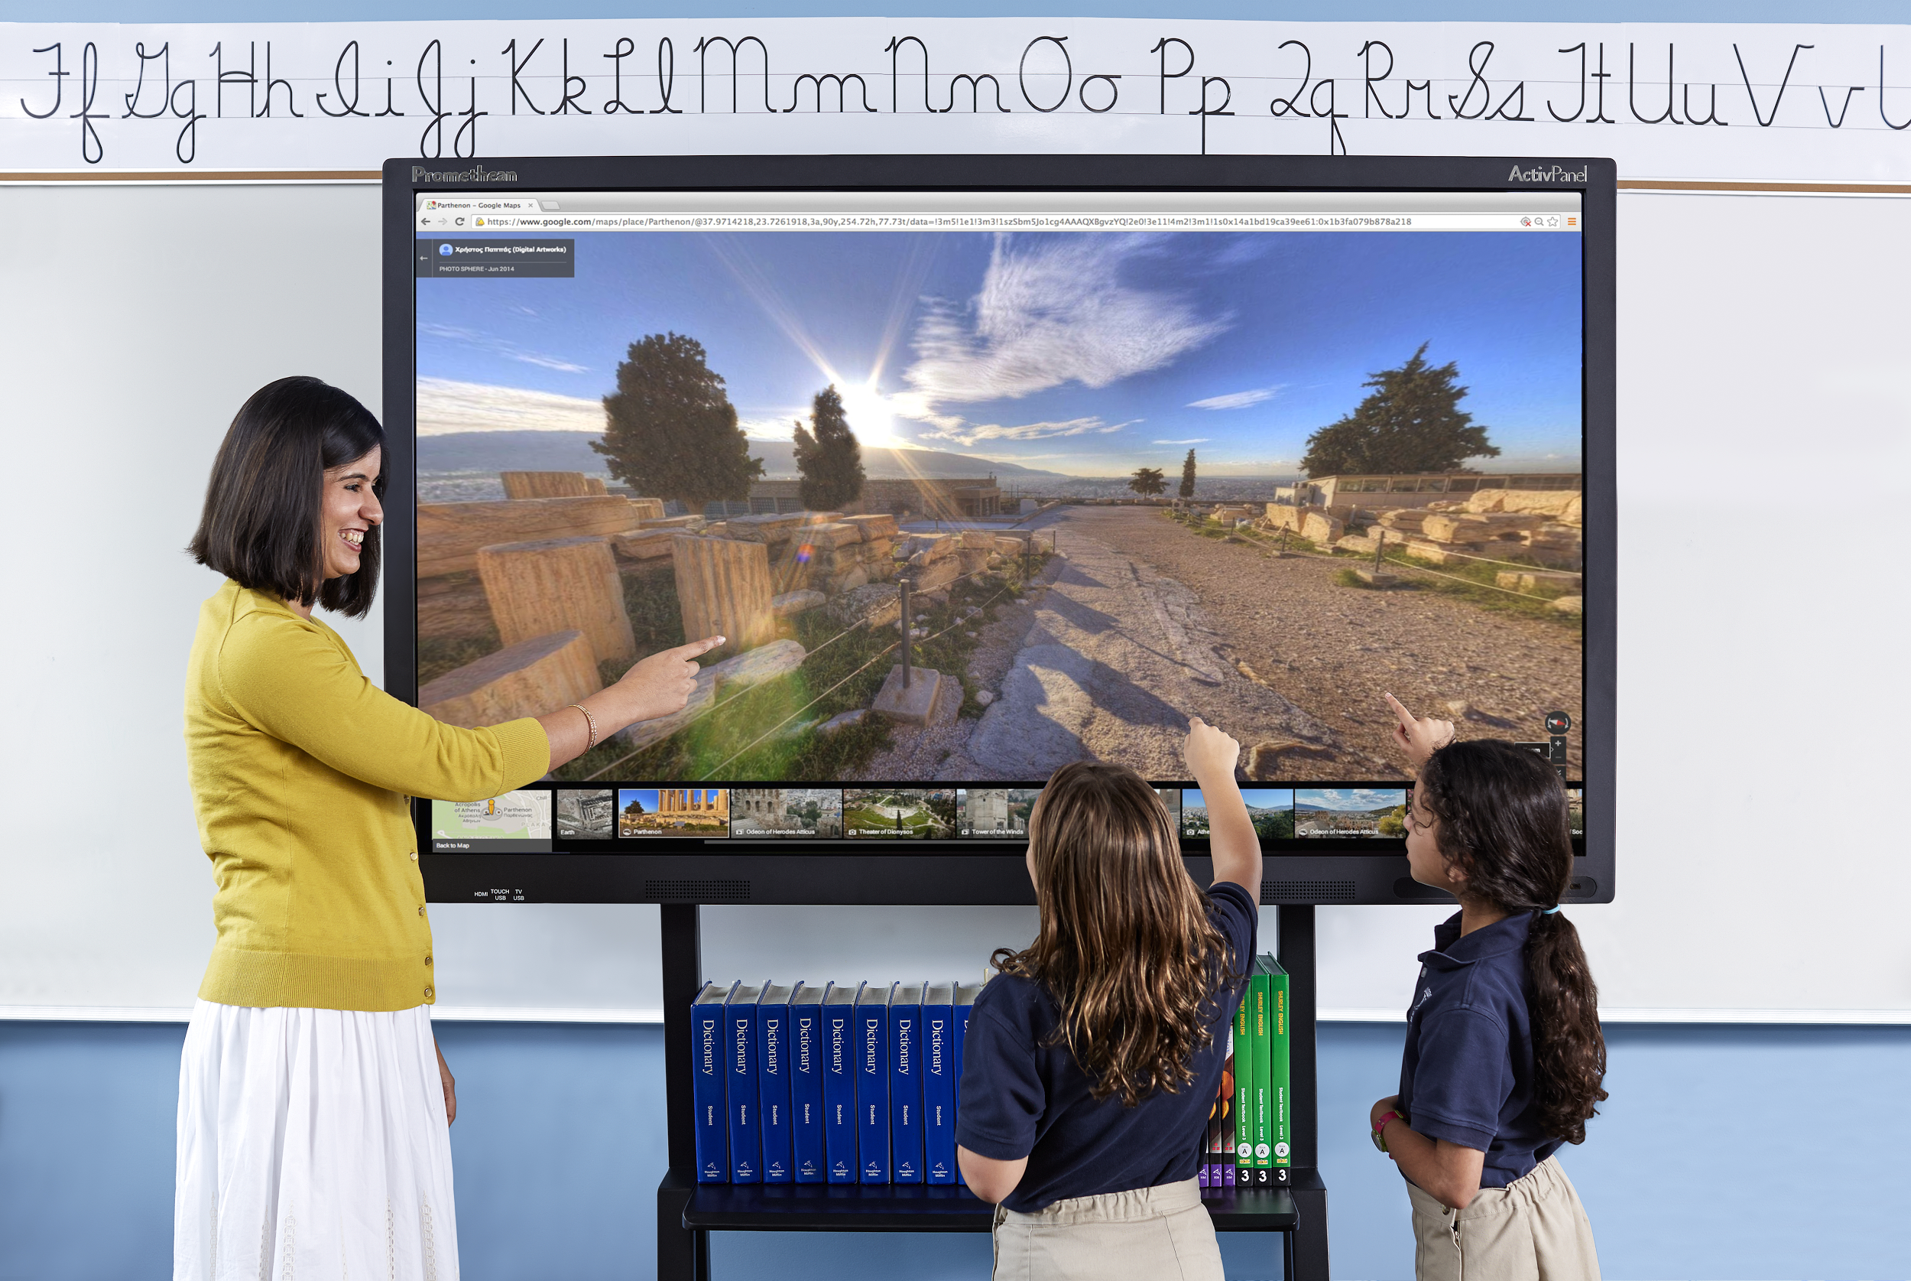
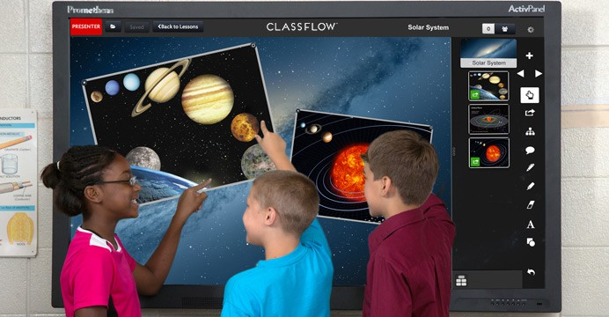
70” Interactive Displays
Replaces aging Smartboards
Eliminates need to orient/calibrate
Room lighting
60,000 hour lifespan
3 or 5 year warranty
1080p or 4K versions
Wall mount or portable
Explored models from InFocus, Recordex and Promethian
Range from $3,999 to $4,999

Slide 7
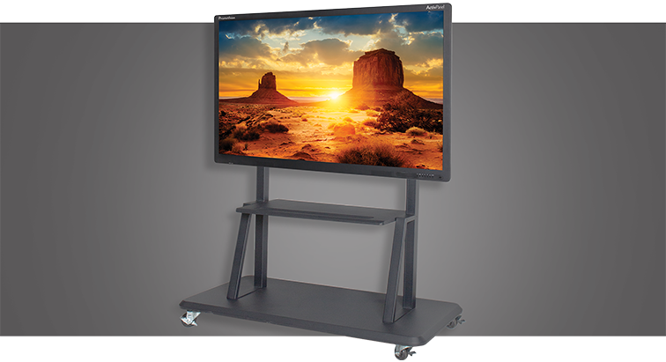
Mounting Options
Direct on wall mount
fixed height
$100-150
Floor to wall mount (over existing chalkboards)
adjustable height
$300-500
Mobile cart
adjustable height
$400-600

Slide 8
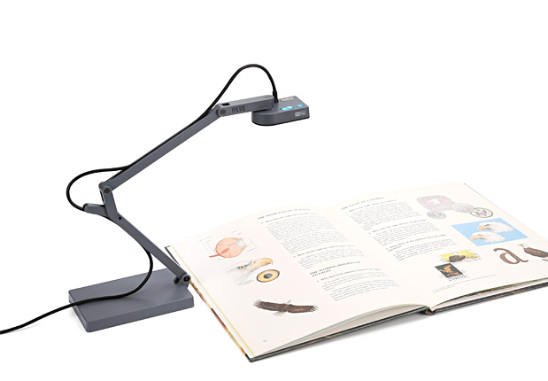
Document Cameras
Auto/continuous focus
Height adjustable
Includes microphone (Skype)
Works with Windows, Mac and Chromebooks
Portable
$100

Slide 9
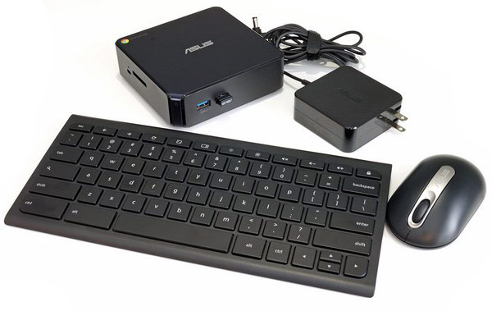
Chromeboxes
Connects to IFP Display (HDMI)
Replaces Windows PC’s
Exact same user experience as Chromebooks
Wired or wireless capable
No annual maintenance fees
Remote management (GAFE)
8 second bootup
Wireless keyboard/mouse included
$249

Slide 10
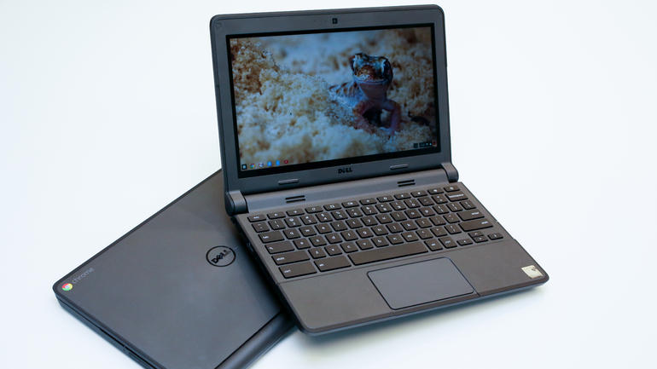
Chromebooks
2016-17 Pilot HS - Grades 9-12
2017-18 Grades 5-8
3-Year Refresh Cycle
Protective Covers Included
180 degree hinge
$275 (includes GAFE license)
Touchscreen

Slide 11
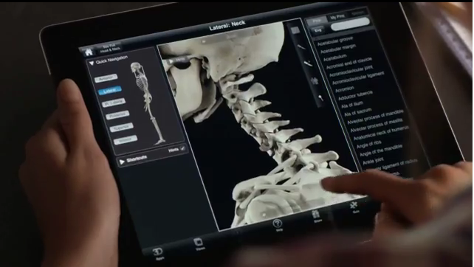
iPads
Expand Availability of iPad Carts
(30) New iPads per cart
(2) carts for Elementary
(2) carts for MS and HS
Available for multimedia projects
iPad Air2 ($499)

Slide 12
Storage/
Charging Carts
Portable, locking storage
(30) iPads per cart
(30) Chromebooks per cart
$800 each

Slide 13
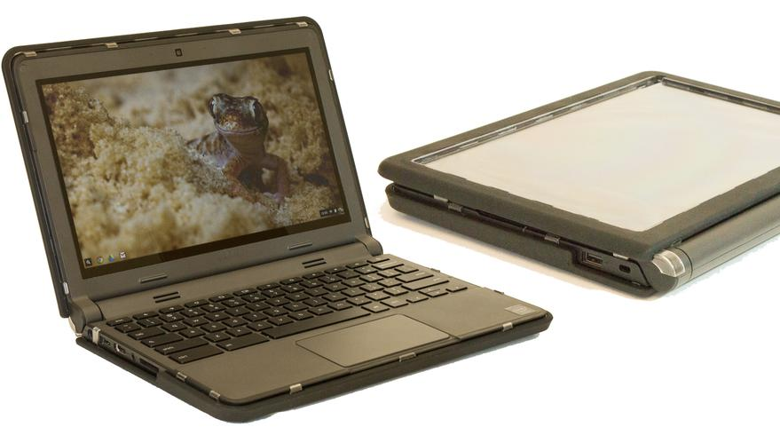
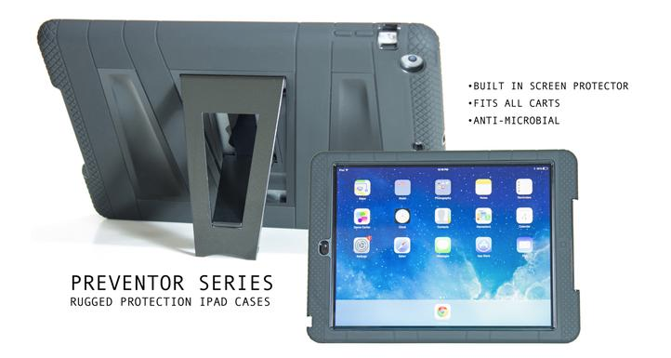
Protective Cases
Always On Rugged Cases
Silicone edges provide shock absorption
We’ve tested evaluation units
$20 each
Ruggedprotection.com

Slide 14
Proposed Budget:
Qty | Description | Unit cost | Line Total
60 | 70" Interactive Touchscreen Displays (5yr warranty & shipping) | $4,275 | $252,000
18 | Security Cameras | $500 | $9,000
30 | TI Calculators Model TBD | $125 | $3750
20 | Bus Cameras | $800 | $16,000
5 | Wireless Access Points | $800 | $4000
50 | Document Cameras | $100 | $5,000
N/A | Cabling and Wiring | $0 | $10,000
1000 | Chromebooks | $275 | $275,000
120 | iPad Air2 | 500 | $60,000
10 | Apple iMac Laptops - 27” | $2,000 | $20,000
N/A | 3D Technology | $0 | $50,000
400 | Protective Cases | $15 | $6,000
N/A | Student Learning Management SW | $0 | $100,000
10 | Mobile Carts | $800 | $8,000
2 | Network Servers | $16,000 | $32,000
 |  | Total | $850,750
 |  | Our allocation | $1,027,801
 |  | Remaining | $177,051

